Slide 1
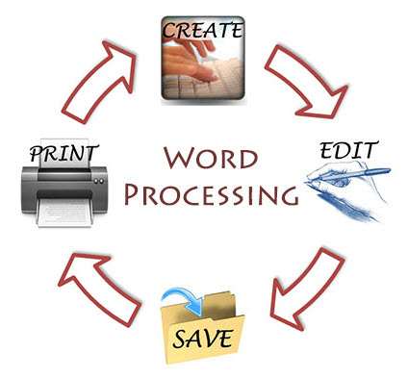
Word Processing

Slide 2
Word Processor
A word processor is software or a device that allows users to create, edit, and print documents. Ex: Microsoft word, text file, libre office.
It enables you to write text, store it electronically, display it on a screen, modify it by entering characters from the keyboard, and print it.
Microsoft Word is a word processor created by Microsoft, and is included in the Microsoft Office software suite.
You may start Microsoft Word by locating the Microsoft Office shortcut folder, and selecting the Microsoft Word shortcut.

Slide 3
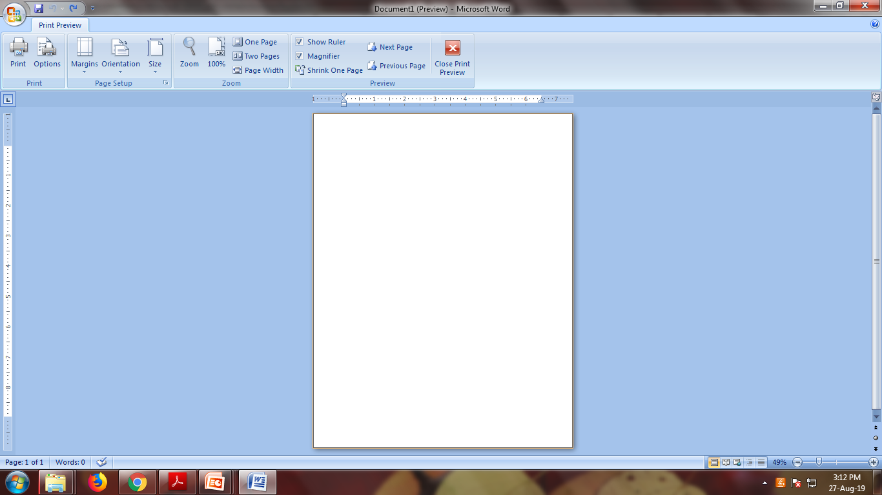
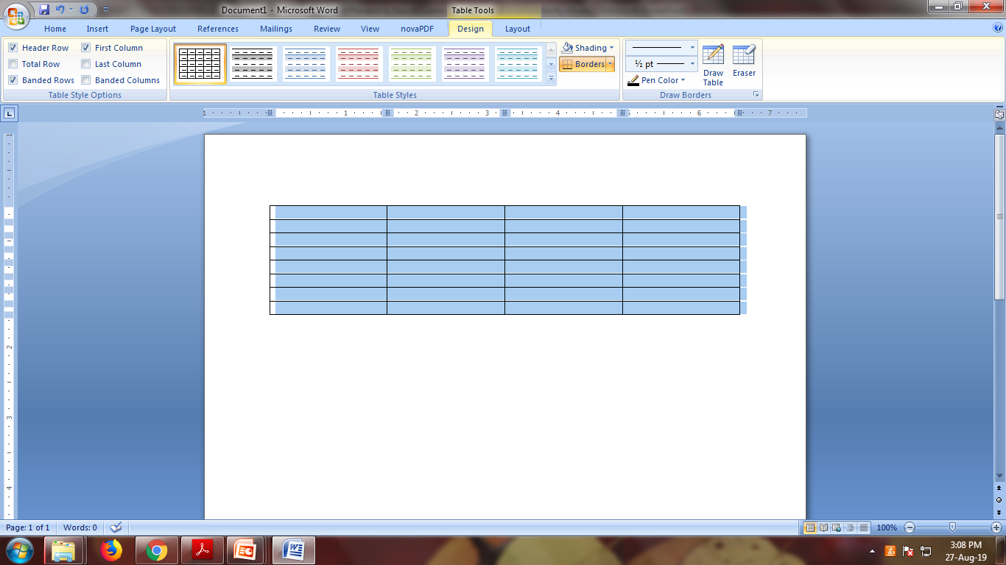
Three Types of Tabs
Standard Tabs (Home, Insert, Page layout, References, Mailing, Review, View, Help).
Contextual Tabs (Ex: Picture tools, Drawing or table)
These are tabs that appear only when they are needed on the type of task.
Program Tab (Ex: Print Preview)
A program tab replaces the standard set of tabs when you switch to certain views or modes.
Contextual Tab
Program Tab

Slide 4
Word Processor Environment
Title bar
Located on the top of the window and displays the names of the application and active document.
Menu bar
Contains different sub-menus, which controls all options, functions and commands. (Ex: Home, format etc.)
Tool bars
Usually positioned just below the menu bar.
Contains buttons that provide single-click entry to carry out many text processing tasks.
By default, only standard and formatting toolbars are displayed in the word environment.
Additional toolbars like drawing and picture toolbars can used from the pop-up menu.
Ruler
Microsoft word contains two rulers, horizontal and vertical.
It is used to change the format of a document by adjusting the indents, margins, tab stops and table columns.

Slide 5
Word Processor Environment (Cont…)
Status bar
Located on the bottom of the word window.
Provides information related to current cursor location, page number, total number of pages and program status notes (spell-check status, overwrite mode indicators etc).
Work area
This environment allows you to type the text, insert images, tables, and many more such actions.
Within this area, the cursor appears, which marks the position where typed character will appear in the work area.

Slide 6
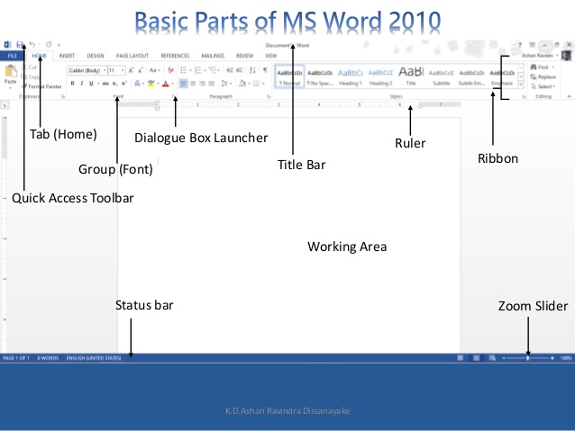
Word Processor Environment (Cont..)

Slide 7
Word Processor Environment – Ribbon Menu System
The current versions of Microsoft Word 10 use what is referred to as the “ribbon menu” system.
The ribbon menus differ from the previous style menus in that the number of possible selections is far smaller, and the menus are not dropdown menus.
Rather, the menus are selectable menus that do not disappear once you move your mouse to another part of the screen.
The “File” menu is the only remaining dropdown menu among the primary menus.
The menu tabs will allow you to navigate Microsoft Word features, and perform various functions.
The different menu tabs typically contain similar sets of features.

Slide 8
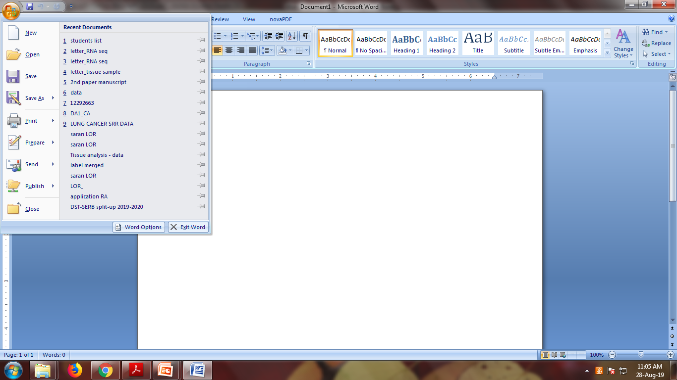
Word Processor Environment – Ribbon Menu System
“File” Menu
This menu will give you access to general options related to the Word file itself.

Slide 9
Word Processor Environment – Ribbon Menu System
“Home” Ribbon Menu
The “Home” menu contains general options such as font sizes, alignment, copy/paste.
The bulk of your time in the menu system will be spent in this menu.
The font size and style controls are located within this ribbon, as shown below.
You may adjust these settings by using the relevant dropdown menus.
“Insert” Ribbon Menu
This menu allows you to insert a variety of non-text objects into your document.
You can use it to add tables, pictures, links, headers and footers, among other things.
“Page Layout” Ribbon Menu
The “Page Layout” menu is where you will do the majority of your document formatting.
You can use it to set margins, page orientation, size, the number of text columns, borders, indentation and spacing.

Slide 10
Word Processor Environment – Ribbon Menu System
“References” Ribbon Menu
The “References” menu allows you to easily cite and reference sources that you may use while creating a document.
“Mailings” Ribbon Menu
The “Mailings” ribbon menu contains a number of features related to documents that will be created for the purpose of being sent in the mail.
You can use these tools to print envelopes and labels, as well as personalizing individual letters in a large mailing to the specific recipient using address and contact information.
“Review” Ribbon Menu
The “Review” menu allows you to review your document for spelling and grammatical errors, insert comments, track (and accept) changes made to your document during reviewing, and compare or combine two documents.
“View” Ribbon Menu
The “View” menu allows you to change how the document is viewed within Word.
The “Zoom” and the “Document Views” sections of this document are where you will spend the majority of the time in this menu.

Slide 11
Document View
Normal View
Displays text with character and paragraph formatting.
Doest show headers and footers.
View separate pages with dotted lines
Web Layout View.
Document appears in a large font and more space in between lines.
This view is used to create document for web.
Print Layout View
Displays document in full preview mode.
All characters, paragraph, and document formatting options are displayed along with headers and footers.
Outline View
Displays document as an outline with expandable and collapsible heading levels.
Used for rearranging entre sections of a document or for moving to specific section in long document quickly.

Slide 12
Primary Tasks
Creating new documents
Opening existing documents
Saving documents
Working with text within documents
Formatting documents
Inserting non-text items
Proofing documents
Printing documents
Closing Documents

Slide 13
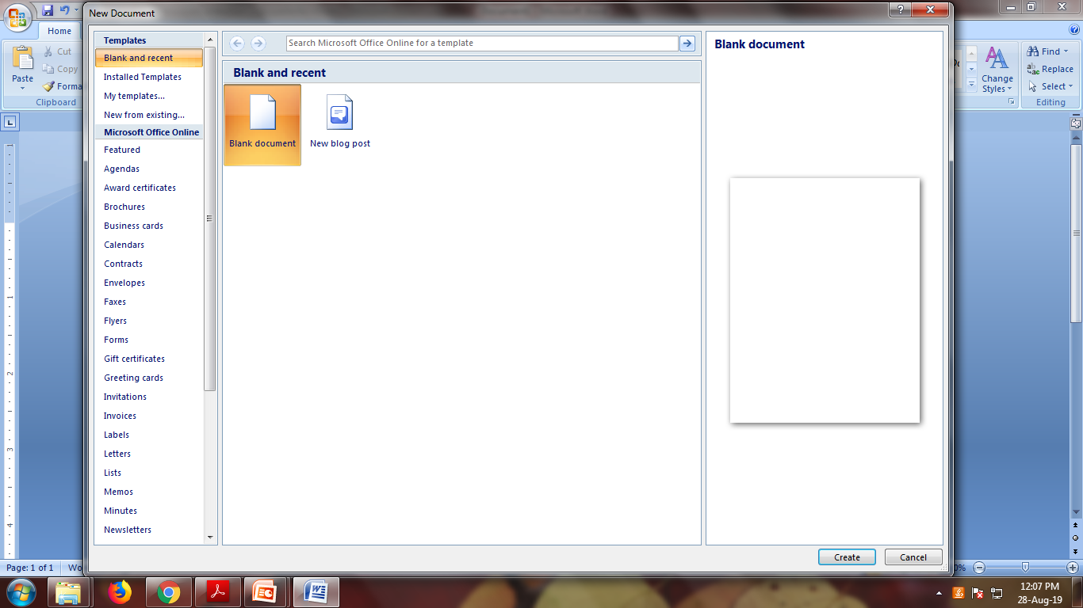
Creating a New Document
Upon starting Microsoft Word, a new blank document will be created.
Alternatively, a new document may be created by selecting the “File” dropdown menu located at the top of the main Word window, and selecting “New”. You must then select the type of new document you would like to create.
Don’t forget to save and rename your document from the default name after creating it.
Alternatively, the keyboard shortcut CTRL + “N” may be used.

Slide 14
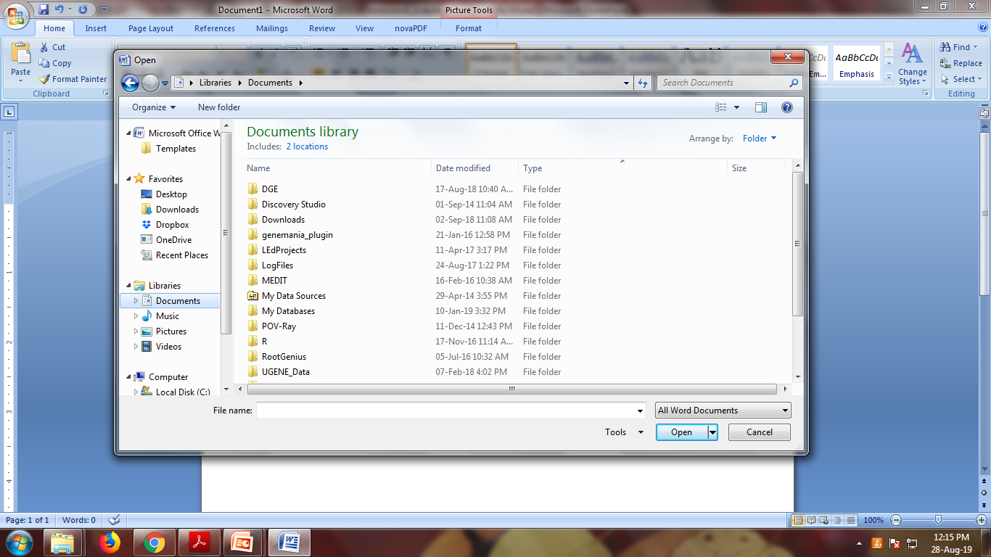
Opening an Existing Document
To open an existing document, first locate and select the “File” menu and select “Open”.
In the dialog box that appears, browse to your file and press the button labeled “Open” located at the lower right corner of this box.
Alternatively, the keyboard shortcut CTRL + “O” may be used.

Slide 15
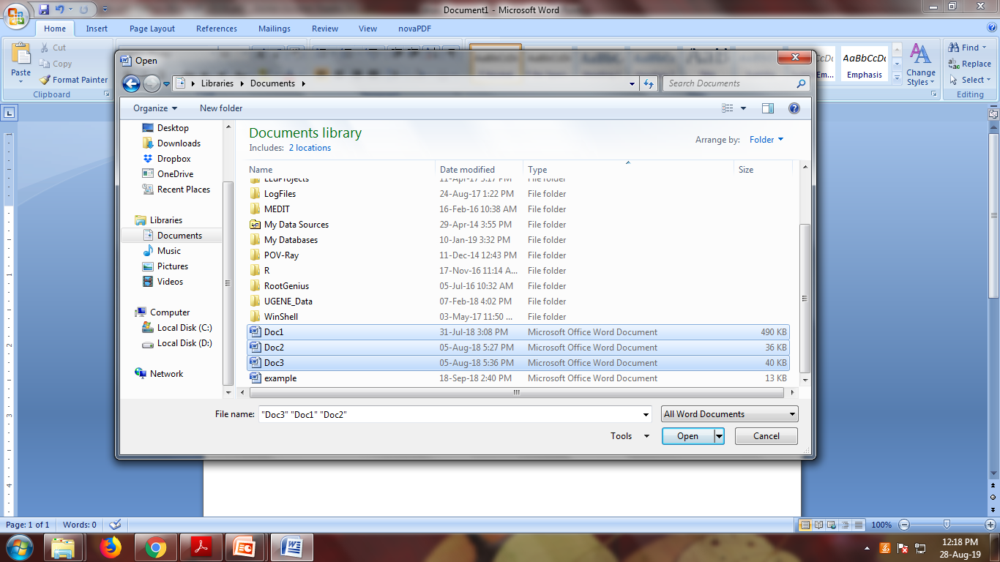
Opening Multiple Documents
Opening multiple documents is very similar to opening a single document.
First, locate and select the “File” menu and select “Open”.
In the dialog box that appears, browse to the location of your files.
The keyboard shortcut CTRL + “O” may be used to access the “Open” dialog box.
To select multiple files, hold the “CTRL” key and click on each of the files you want to open.
Alternatively, you can hold the “Shift” key and then use the arrow keys to select multiple consecutive documents in a row.
Once you have selected the desired documents, press the “Open” button.

Slide 16
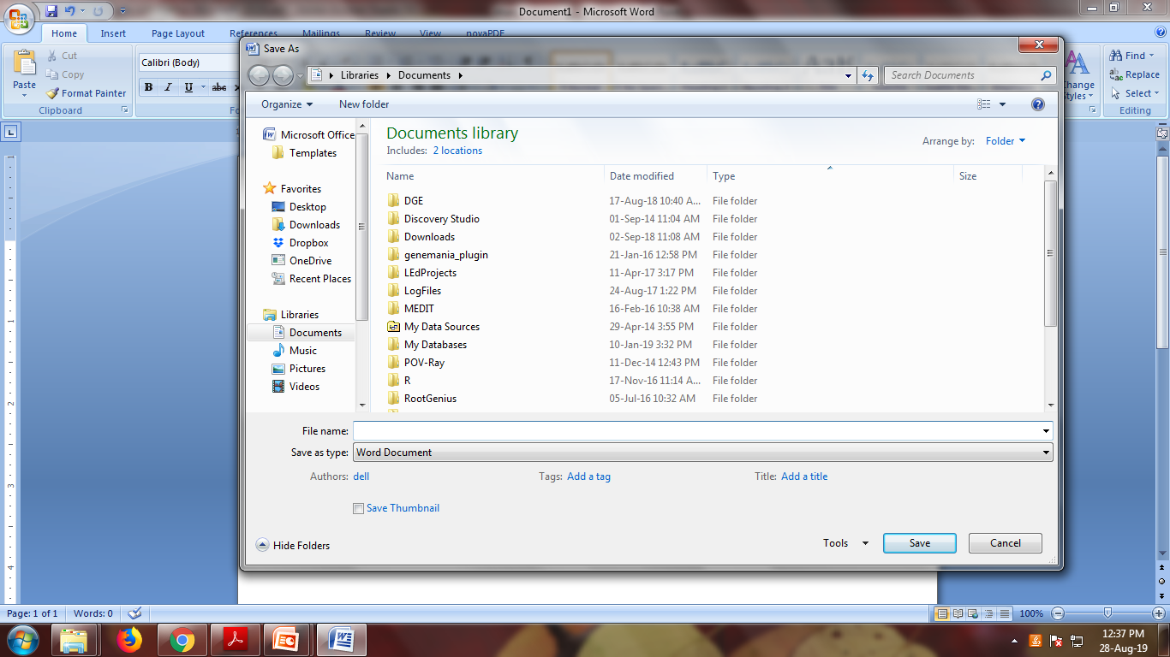
Saving a Document for the First Time
If you are saving a document for the first time, you should specify a file name and the location to which the file will be saved.
To save a document for the first time, select the “File” dropdown menu, and select “Save as”.
The “Save as” window will appear, at which point you should locate and select the location that you want the file to be saved to, as well as naming the file what you would like it to be called.

Slide 17

Saving a Document
To simply save a document without renaming or relocating it, locate and select the “File” menu.
Select the “Save” option.
Alternatively, the keyboard shortcut CTRL + S may be used.

Slide 18
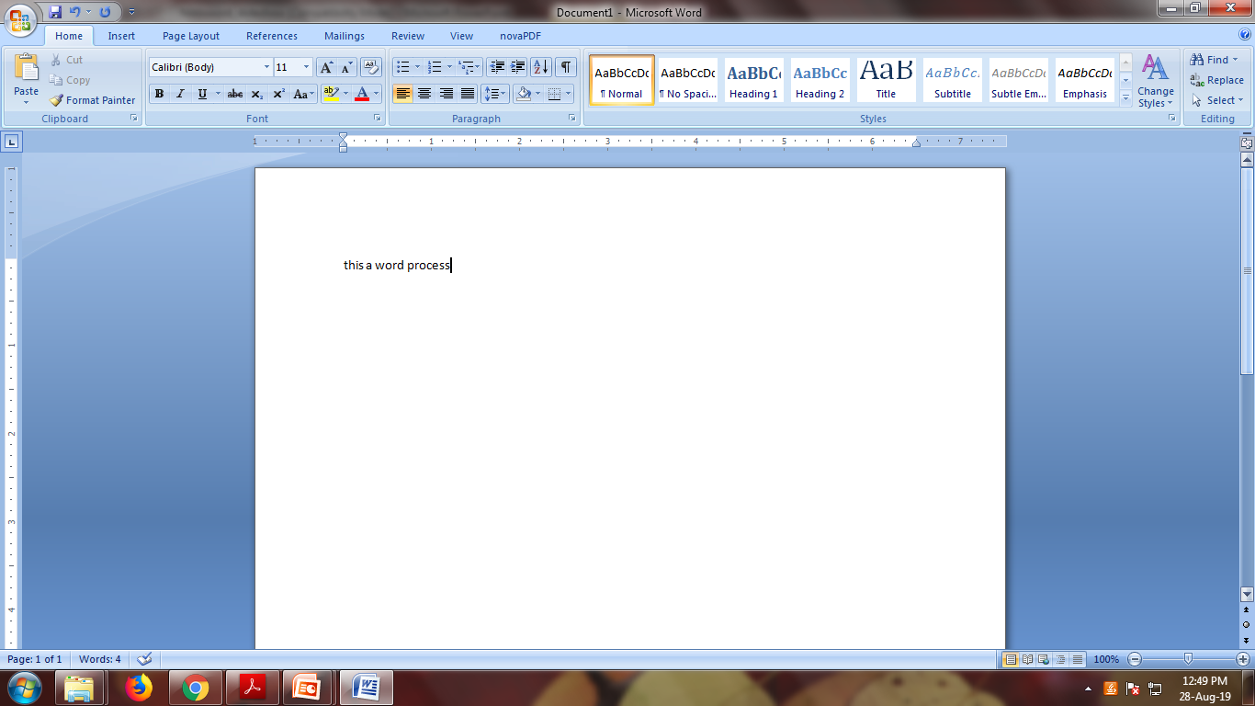
Working With Text
In addition to simply typing words into a document, you can highlight, select, copy, cut, and paste items using either standard Windows shortcut methods, or buttons in Word.
To select a block of text, click and hold the left mouse button at the beginning portion of the block you wish to select, and then drag the mouse over the desired text. You will notice that the text will be highlighted as you do this.
Once you have the desired text selected, release the mouse button.
Note that while clicking on another part of the document while you have text selected will deselect it.

Slide 19
Working With Text (Cont…)
Once you have the desired content selected, you can cut, or copy it to use it in another location.
To cut the selected content, locate and select the “cut” button in the “Clipboard” portion of the “Home” ribbon menu. This will remove the selected content from its current location and allow you to use it elsewhere. (keyboard shortcut: “CTRL” + “X”)
To copy the selected content, locate and select the “Copy” button in the “Clipboard portion of the “Home” ribbon menu. This will copy the selected content, allowing you to use it elsewhere without removing it from the document. (keyboard shortcut: “CTRL” + “C”)
To paste the text, locate and select the are of the document in which you would like to paste, then locate and select “Paste” button located in the clipboard portion of the “Home Ribbon Menu. (keyboard shortcut: “CTRL” + “V”)

Slide 20
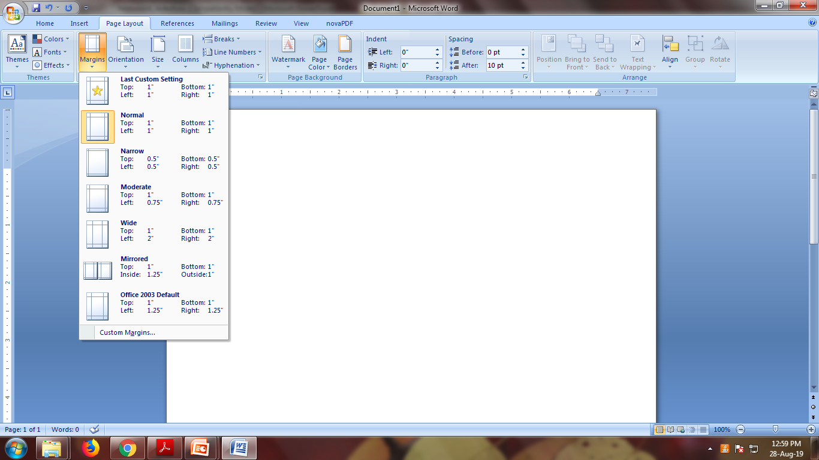
Formatting - Margins
To set margins, locate and select the “Page Layout” menu.
Select the “Margins” button.
A number of preset margin settings will drop down in a menu. You can select one of those, or select “Custom Margins” at the bottom of this menu to specify your own.
A dialog box will appear. The basic margin settings are located at the top of this box.
Also note the “Orientation” portion of this menu.

Slide 21
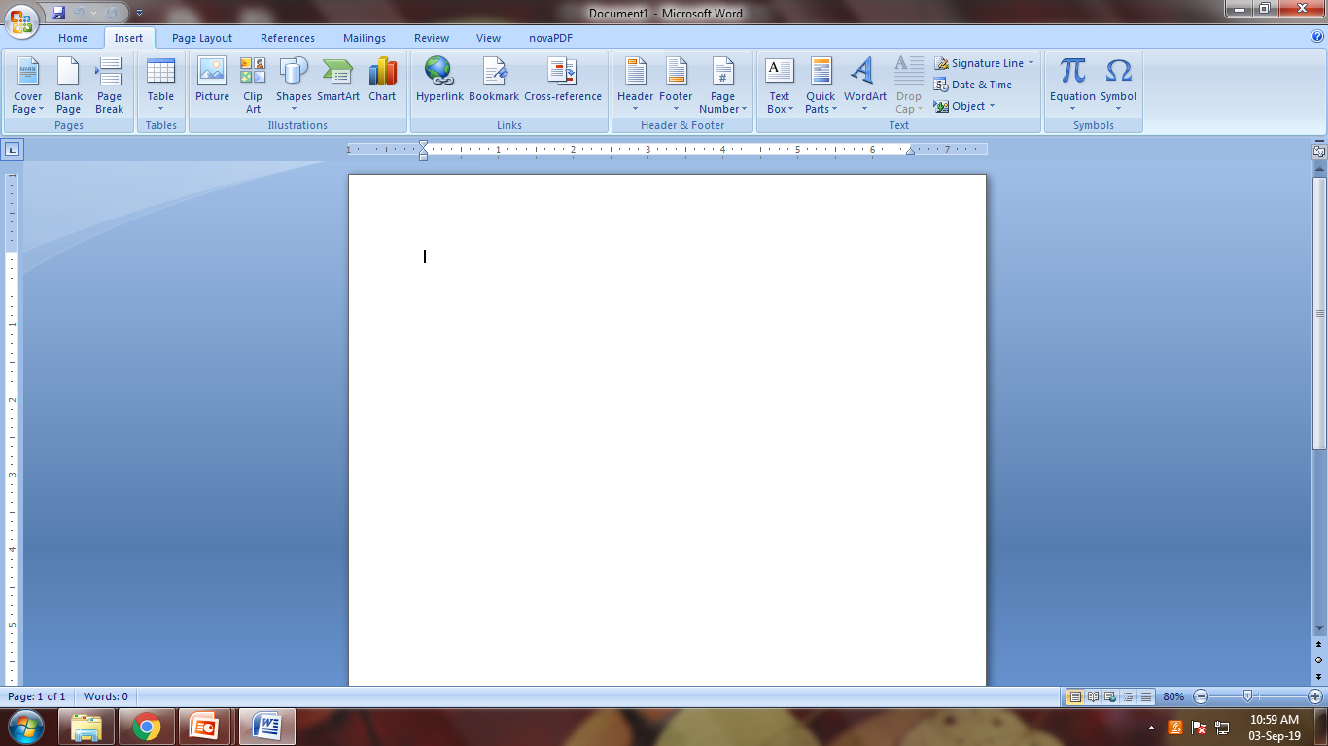
Formatting – Headers and Footers
Options for headers and footers will be located in the “Insert” ribbon menu in the “Header & Footer” section.
To add a header, or footer, press the “Header”, or “footer” button.
A dialog box will appear which will allow you to specify the type of header that you would like to add.
To just add a simple header, select the “Blank” header.
To navigate to or away from the header, just double-click on the area of the document that you would like to move to.

Slide 22
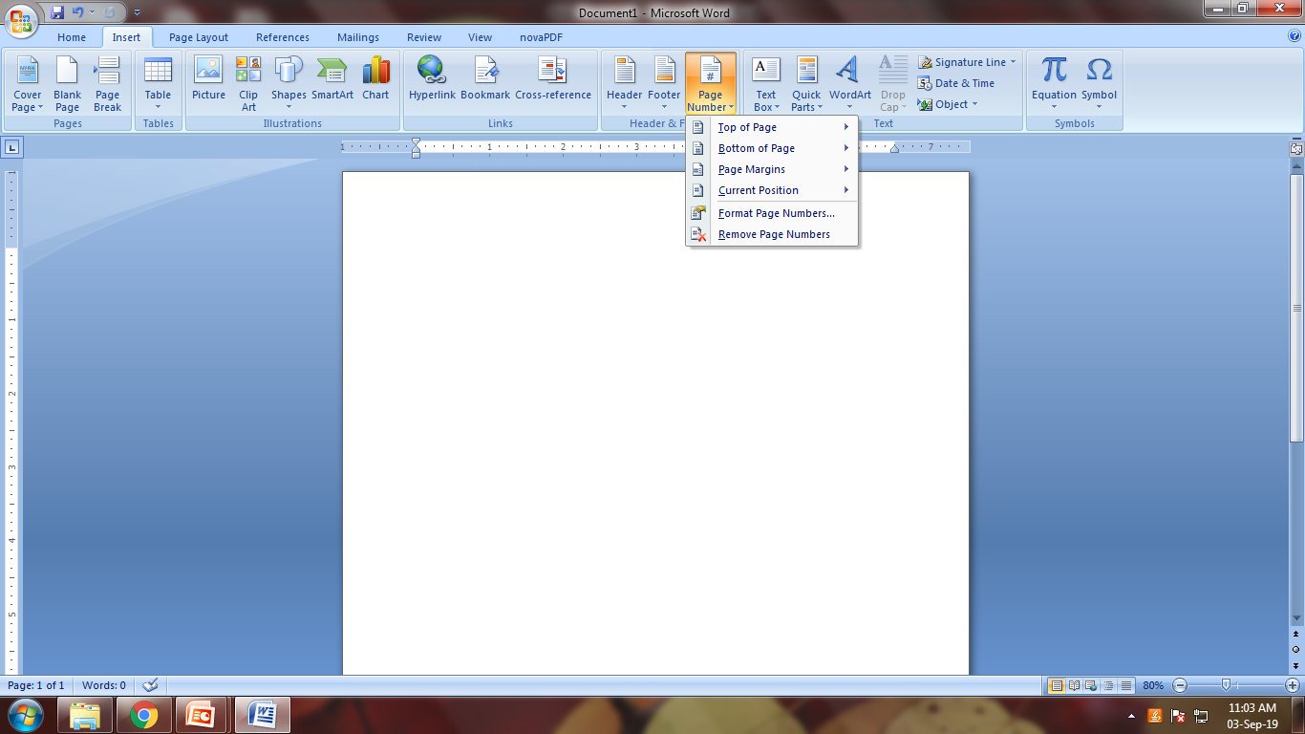
Formatting – Page Numbers
Page numbers are a very commonly used header element.
To add page numbers to your header or footer, first create and select a header or footer.
After you have created a header or footer, locate and select the “Page Number” button located in the “header and footer” portion of the “insert” ribbon menu.
In the dropdown menus that appears, select the location in which you want to place your page numbers.

Slide 23
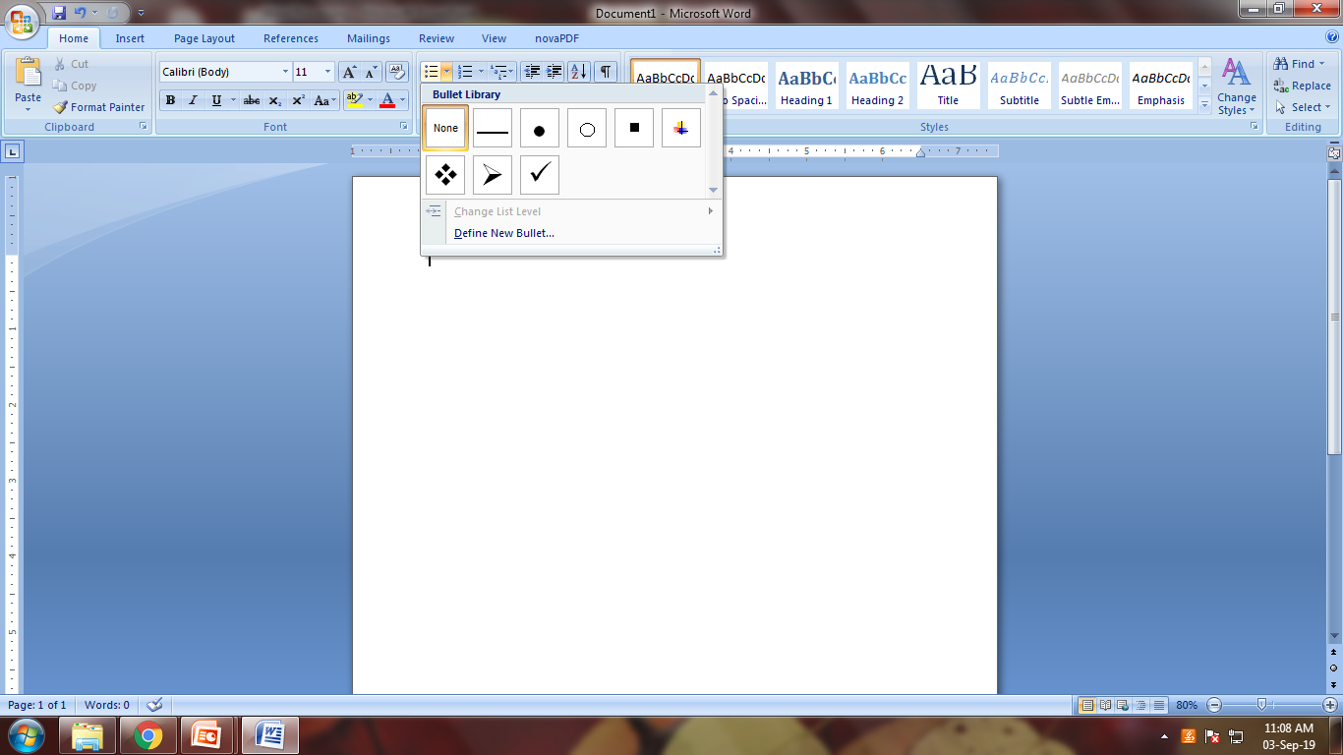
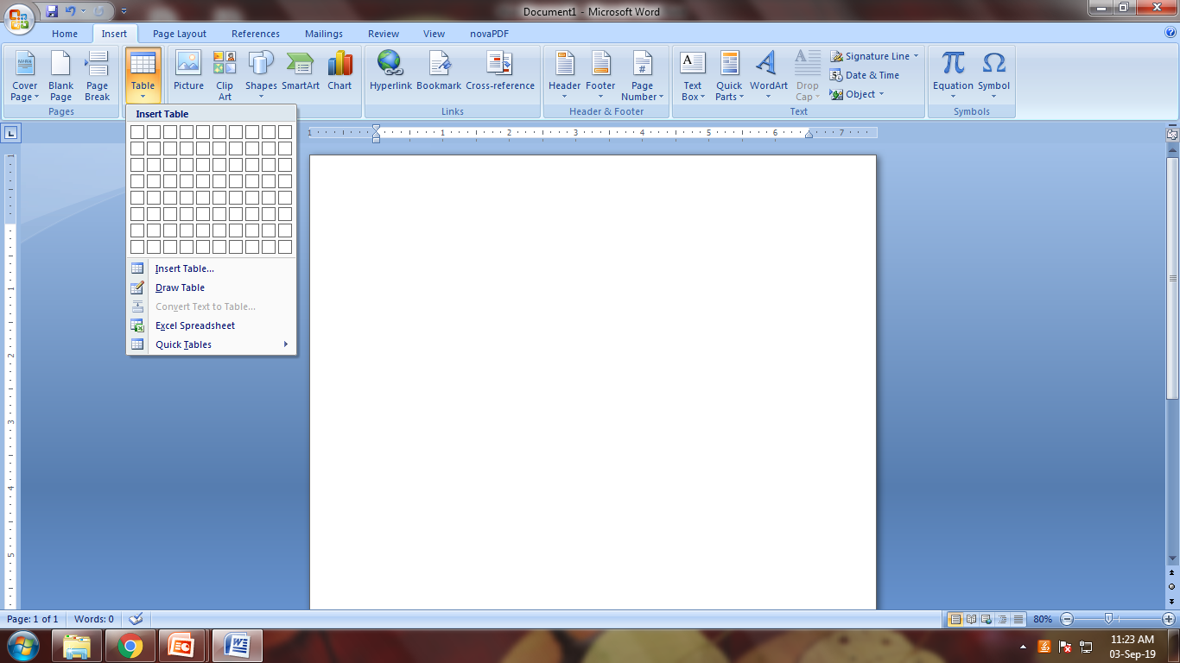
Non-Text Items - Bullets and Table
Bullets
To use bulleted lists, find and select the “Home” menu.
Select the bullet button located the “paragraph” section of this menu to start the list.
To create the next bullet in the list, press “enter”.
Tables
To insert spreadsheet-like tables, first select the “Insert” menu.
Find and select the “Table” button located in the “Tables” section of this menu.
In the menu that appears, use the table graphic to select the size of the desired table by clicking on the graphic in the appropriate location.

Slide 24
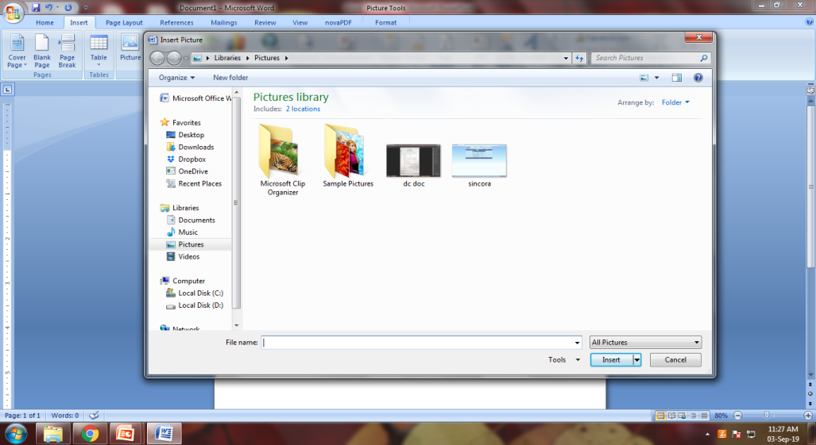
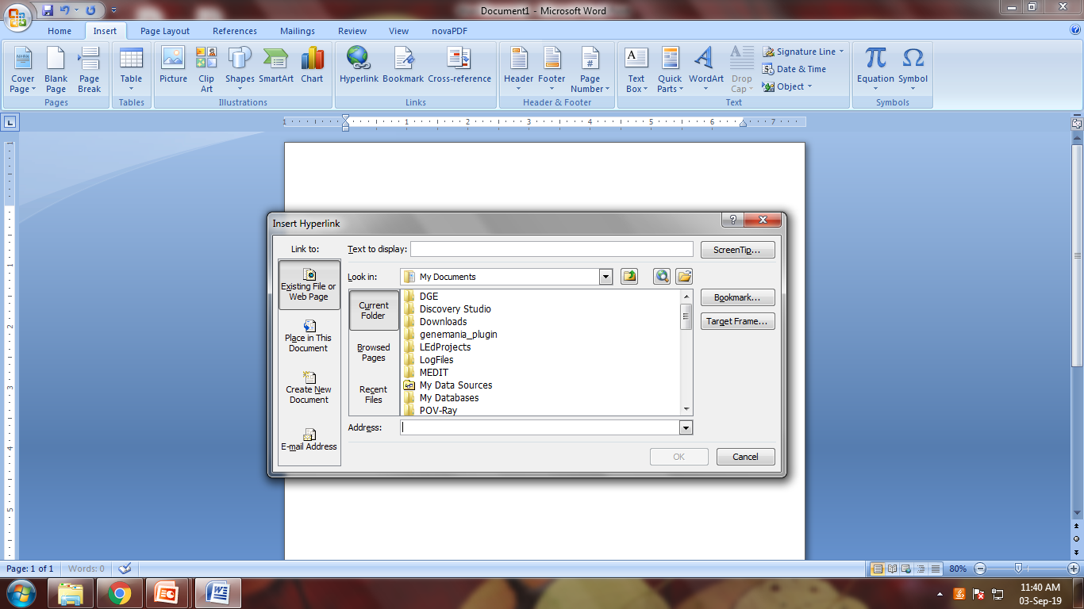
Non-Text Items - Images and Hyperlinks
Images
To insert an image into your document, first select the “Insert” menu.
Locate and press the “Picture” button in the “Illustrations” section.
In the Dialog box that appears, browse to the photo you wish to insert and press the “Insert” button.
Hyperlinks
To insert a hyperlink into your document, select the “Insert” menu.
Locate and select the “Links” button.
In the dropdown menu that appears, select the “Hyperlink” button.
You can either browse to a location using the “Look in:” section of this window, or you can type an address manually in the “Address:” bar at the bottom. When you are done, press the “Ok” button located at the bottom of the screen.

Slide 25
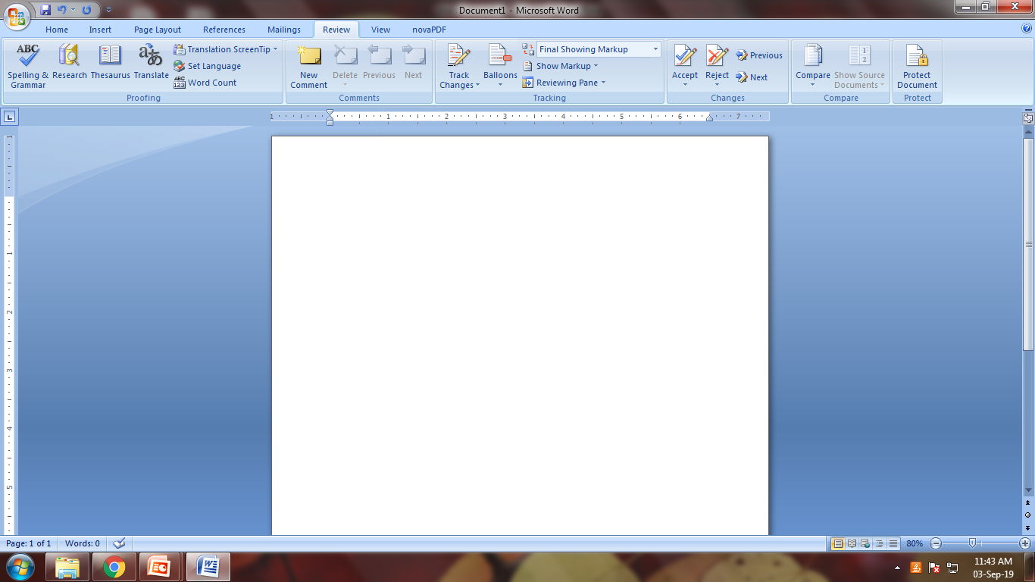
Proofing Tools - Spellcheck
To check your document for spelling errors, use the spell and grammar check feature.
Select the “Review” menu.
Select the “Spelling & Grammar” button in the “Proofing” section of the menu.
Alternatively, press F7 to initiate the check.
In the “Spelling and Grammar” check dialog box, you can enter corrections manually in the top text field.
Alternatively, you can select from a list of “suggestions” located in the lower half of the dialog box. Make your desired selection and press the “Change” button.

Slide 26
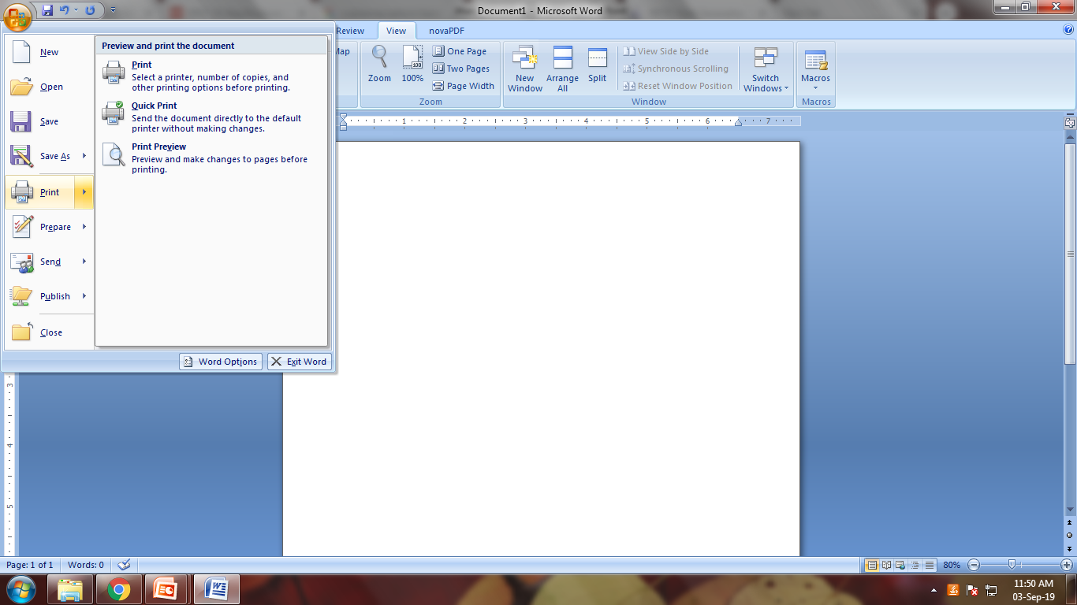
Print Options
You will find the options related to printing by selecting the “File” menu, and selecting the “Print” option. The Word window will then be populated with options related to printing.
The most important options are located at the top of the window.
Make sure that you have the desired printer, and the desired number of copies to print selected.
When you are ready to print, press the “Print” button located in the upper portion of the screen.

Slide 27
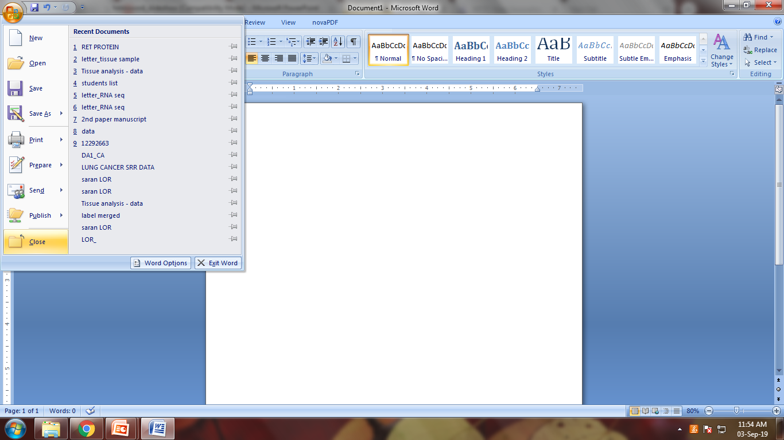
Closing Documents
To close a document without exiting Word, find and select the “Close” button in the “File” dropdown menu. This will close the document without closing that instance of Microsoft Word
To close the document and the Word program, you can select the “X” in the upper right hand corner of the window, just like any other application in Windows. (keyboard shortcut: “ALT” + “F4”)

Slide 28


